Slide 1

Developing Student Career Services in Georgia
Paul Hacking and Martin Pennington
(on behalf of University of Essex)
TEMPUS CASEDE Project

Slide 2

What do you know about Georgia?

Slide 3
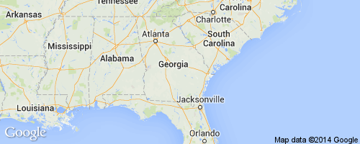
Hopefully more than the NHS!
From NHS National Blood Service website

Slide 4
1. What is the population of Georgia?
4,935,880 (Scotland: 5,295,000)
2. How big is Georgia?
69,700 sq km (slightly smaller than Ireland and slightly bigger than Lithuania)
3. What is the capital of Georgia?
Tbilisi (population 1,175,200 in 2012)

Slide 5
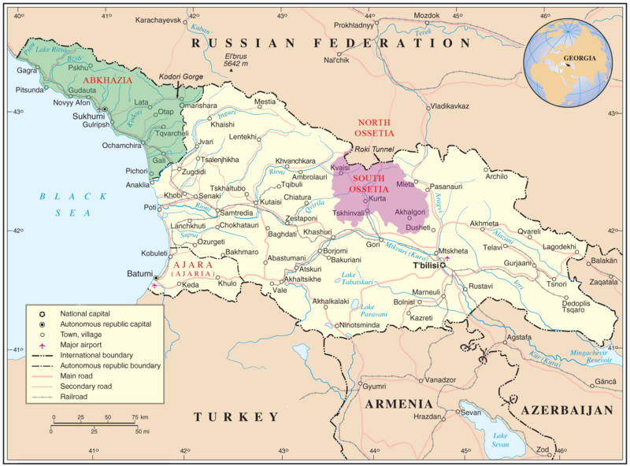
4. Who are its nearest neighbours?

Slide 6
Recent Georgian history
Gained independence from USSR in 1991
Civil and economic unrest for most of 1990s
Rose Revolution 2003 brought democratic and economic reforms
War with Russia in South Ossetia in 2008
Member of the Council of Europe, World Trade Organisation and the GUAM Organization for Democracy and Economic Development
Georgia and EU signed Georgia-European Union Action Plan in 2006

Slide 7

Recent Georgian history
Growing US and EU influence in Georgia notably through proposed EU and NATO membership and the US military assistance program

Slide 8
Georgian economy
In 2007 Georgia's real GDP growth rate was 12% (one of the fastest growing economies in Eastern Europe)
High unemployment rate of 12.6%
Low median income compared to European countries (c$200 per month in 2005)
In 2006 34% of population lived below the national poverty line (in 2001, this was 54%)
Main imports are natural gas, oil products, machinery and parts, and transport equipment
Tourism is increasingly significant - about a million tourists brought $313m to the country in 2006
Four UNESCO World Heritage Sites

Slide 9
Georgian people
c84% of the population are ethnic Georgians
Other ethnic groups include Russians, Armenians and Azerbaijanis
Georgian is the first language of c71% of the population (others include Russian, Armenian and Azerbaijani)
A large majority of Georgia's population practises Orthodox Christianity

Slide 10
Famous Georgians
Joseph Stalin - leader of the USSR
Eduard Shevardnadze - Foreign Minister of USSR and President of Georgia
Pyotr Bagration - prominent general and opponent of Napoleon
Lavrentiy Beria - chief of the USSR secret police
Alexander Borodin - composer
Shota Rustaveli - poet
Katie Melua – singer/songwriter
Georgi Kinkladze - footballer (Manchester City and Derby County)

Slide 11
Education in Georgia
Sweeping changes since 2004
Mandatory for all children aged 6–14
Divided into:
- elementary (age 6-12)
- basic (age 12-15)
- secondary (age 15-18)
Secondary school certificate gives access to HE
Passing the Unified National Examinations allows entry to a state-accredited HE institution based on ranking of exam scores
c34 tertiary level students per 1000 people (UK: c38)

Slide 12
Higher education in Georgia
72 higher education institutions accredited by the Ministry of Education and Science:
Colleges (13) – professional programmes and/or only Bachelor programmes
Teaching University (31) – programmes up to and including Masters level
University (28) – programmes up to and including Doctorate level

Slide 13
TEMPUS Project partner institutions
Vilnius University (lead)
Corvinus University, Budapest
University of Essex
Georgian partners:
Samtskhe Javakheti State University (Akhaltsikhe)
Batumi Shota Rustaveli State University (Batumi)
Ivane Javakhishvili Tbilisi State University (Tbilisi)
International Black Sea University (Tbilisi)
University of Georgia (Tbilisi)
Iakob Gogebashvili Telavi State University (Telavi)
Shota Meskhia State Teaching University (Zugdidi)

Slide 14
Project aim and objectives
To improve Georgian students’ employability by developing and implementing career education services (CES) in Georgian partner HEIs
To prepare methodological and IT tools for providing CES for students at Georgian HEIs
To train the staff of Georgian HEIs to provide CES for students
To implement pilot CES for students at Georgian HEIs
To explore possibilities for CES implementation at all Georgian HEIs
To organize dissemination of the project results in periodical press, at the website and using other channels

Slide 15

Value of the project
1,145,899 Euros requested
for this 2 year TEMPUS project
883,661 Euros accepted
Notes:
The main reason for the lower sum to fund the project was the rejection of ‘software’ requirements. The majority of the costs were for staffing & travelling but also some equipment, books & printing, publishing costs. The project involved 24 ‘mobility's’ – so there was a lot of travelling and meetings held in all the partner institutions. 3 colleagues (EU Experts) attended all 24 mobility's. Martin & I sometimes prepared online powerpoint presentations for the meetings to reduce the travelling. Although a representative of the University of Essex was in attendance at most project meetings.

Slide 16

Main outcomes of the project
1. Georgian Careers Competence Model
2. Career Management Student Programme
3. Training programme for Georgian university colleagues
4. Staff Career Management Guide
5. Student Career Management Guide
6. Career Service Guidelines
7. National Careers Services website
8. Careers Partnership Agreement
Notes:
The work was divided into work packages which covered all of these tasks plus other aspects such as the evaluation of some of these outcomes & research into other aspects such as the views of employers, students & university staff on graduate employability. Martin will cover these aspects later. We will now look at each of these outcomes individually. We don’t have time to discuss these in detail – so this is just a flavour of what the main outcomes of the project were. But you can ask us questions following the presentation & we can forward the presentation to you following the session today when we can answer your queries by email.

Slide 17
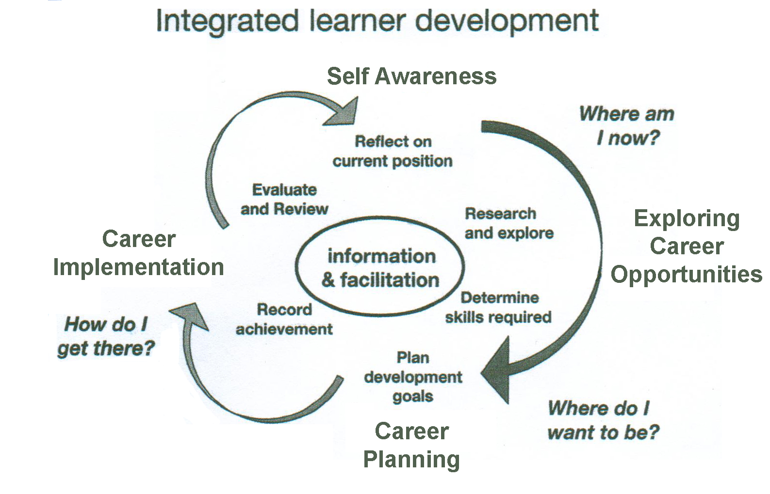
1. Georgian Careers Competence Model
Notes:
As you can see there are 4 interrelated domains self awareness, exploring career opportunities, career planning & career implementation. It is similar to the DOTS model (decision learning, opportunity awareness, transition learning & self-awareness) – Tony Watts & Bill Law will be pleased to know that the careers model they developed has been re-invented & adopted in Eastern Europe.

Slide 18
Competencies structure in domains
Each competency has 3 structural elements:
Knowledge
Skill
Attitude
Notes:
Each domain has 3 elements knowledge, skill & attitudes

Slide 19
Self awareness domain
Aware of personal factors important for career (competence)
Understands importance of positive self image to career (knowledge)
Is able to assess own strengths & weaknesses (skill)
Dares to take risks & seeks to openly explore self (attitude)
Notes:
This is just an example for self awareness. Interestingly when we first presented this model to our Georgian colleagues at a meeting in Tbilisi – which a wide range of HEI’s in Georgia were invited the self awareness domain was the one they were most sceptical about. Can you teach self awareness & if so how - was there challenge. This meeting was covered by national TV so the project had a high profile.

Slide 20

Exploring career opportunities
Exploring work opportunities & drawing personal implication (competence)
Knows different forms of employment (knowledge)
Able to use labour market information for personal career management (skill)
Has positive attitude to business start up (attitude)
Notes:
This is an example for exploring career opportunities. Anyone want to guess where the picture is from?

Slide 21

Career Planning
Creation of a broad & adaptable career vision (competence)
Knows concept of career vision & its importance for career success (knowledge)
Is able to define career vision (skill)
Displays openness to various career opportunities (attitude)
Notes:
An example of career planning

Slide 22
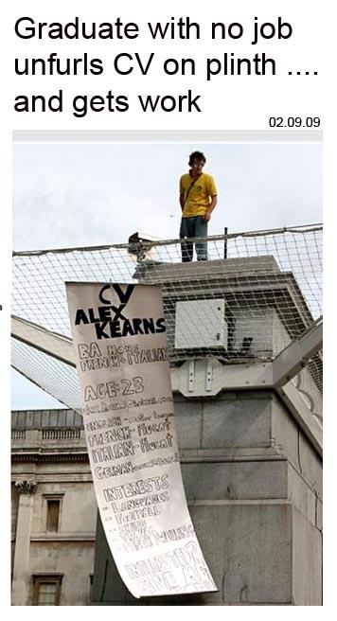
Career implementation
Job search process management (competence)
Knows how to prepare job search documents
eg CV (knowledge)
Is able to secure help of contacts in job search process (skill)
Seeks to assume learning goals & outcomes (attitude)
Notes:
An example of career implementation

Slide 23

2. Career Management Student Programme
15 week course taught in English
Piloted in all the partner universities mainly in the Spring semester 2014
Some universities, e.g. International Black Sea, ran several pilot courses
Notes:
Read slide – in fact IBS university ran 8 student programmes

Slide 24
Learning outcomes
Students will:
know & understand key factors affecting career development success
demonstrate they have the skills to apply theory & practice of career development
have developed positive, realistic & resilient attitudes & values that underpin career development success
Notes:
Allow time for delegates to read. A major strength of the programme was it wasn’t just focussing on job hunting techniques – which is often the case today. All these programmes were evaluated both before the course (in terms of student expectation) & following the course (in terms of whether these expectations had been met & what had worked well & what hadn’t). Generally the feedback was very positive – although some students struggled with the theoretical elements.

Slide 25
Course structure
Student contact working hours – 30
Independent working hours – 20
Teaching & learning methods a combination of teacher guided, research, reflective & task based learning, group work, individual study & autonomous learning.
Notes:
Allow time for delegates to read slide. 30 hrs – are 15 - 3 hour sessions

Slide 26
Course topics
What career means in changing world
Career development theory & practice
Self-awareness & its impact on career
Researching & exploring career options
Presentation of research results on own career options
Career vision
Career decision-making
Career planning
Exploring learning options
Graduate recruitment & what employers are looking for
Job application documents
Job interview
Being successful at work
Management of career changes
Notes:
If you want more information on elements under each topic – we can provide this. Explain research task. This involved desk based research on a chosen career field & informational interview with a person working in a job the student is interested in. The criteria for conducting the research is in Student Career Management Guide. Will explain more under assessment. It is interesting to note that the course topics covered under this career management course is much broader than would normally be covered in the UK. For example personal resource management covers resources needed for career eg money, time, social network, health, lifestyle etc. Likewise ‘being successful at work’ covers expectations from new job, understanding organizational culture, work/life balance etc.

Slide 27
Assessment
Version A:
The overall course mark must be 51% or above to secure a pass
Version B:
Four bands of marks: 0-51 (fail), 52-70, 71-80, 81-100
All pieces of course work have to be submitted to secure a pass mark
Assessment methods include: report, case studies, self-reflection, project work & presentation
Common to both versions were three assessed components:
research project report on own career options (50%)
job application package (20%)
career development plan (30%)
Notes:
Believe it or not we had a very lively discussion on how to assess the course which is why we opted for 2 versions. David Stanbury & I were very much in favour of version A. Mainly because we thought the value was in the student actively embracing the ideas presented in the course & too much emphasis on your pass mark would detract from this. Version B may be more appropriate if the course is to form an accredited element of a degree course. The course work requirement is the same for both the criteria for assessment is different for the 2 versions. You can also see the different elements of the course work are weighted. 1. a presentation of the sector & an analysis of the current state of the labour market in this sector & future trends. Interviewee’s job role & work environment. Interviewee’s career story & identifying things such as transferable skills & how this has influenced student career development plan. An analysis of how an appropriate career development theory could be applied to interviewee’s progress in career. Impact this research has had on own approach to career planning. 2. CV, letter of application, reflection statement on mock interview. 3. To write own career development plan – can give details later if requested.

Slide 28
3. Staff training programme
Part 1 – one week:
40 contact hrs, 15 independent hrs
Part 2 – 3 days:
24 contact hrs, 30 independent hrs
Purpose: to develop the competencies of Georgian HE staff for delivery of career education programme
Notes:
Part 1 essentially takes trainees through each lecture of the student programme to demonstrate how to teach it with the opportunity for delegates to try out the student exercises. The staff who participated in this training were all experienced HE lecturers most with only a limited, if any, background in careers. About 15 staff participated in this training representing all the Georgian project partner institutions.

Slide 29
Staff training part 1
Includes:
concepts of career & career management
different models of career education, linking pedagogy to careers theory, role of lecturer & assessing careers education
plus how to deliver each of the elements of the student programme
Notes:
There is a strong theoretical basis to the programme but with a very practical application. It was a challenge to combine the two. Again the programme was evaluated and feedback was generally very positive. Delegates would have liked the training to have been longer. The elements they struggled most with was the theoretical concepts.

Slide 30
Staff training part 2
To enable a trainer to:
understand student Career Management Competencies Framework
formulate learning objectives
practise particular methods & tools to effectively deliver Student Career Management Programme according to individual teaching plans
Notes:
There was a gap of about 5 weeks between part 1 of the staff training & part 2. Part 2 was an opportunity for delegates to reflect on part 1 & then put into practice what they had learnt such as devising a course plan & trying out various career education tools as they applied to the course.

Slide 31
Staff training – how to establish & run an HE career unit
Aimed at a different audience from careers education programme - mainly administrative & management staff in HE
16 contact hours
Notes:
Delegates participating in this training often had very little understanding of careers work in its broadest sense. It was a 2 day wprkshop.

Slide 32
Career unit establishment training
Purpose included helping staff to:
develop mission statement, goals & objectives of career services programme
develop career unit facilities, e.g location, design & layout, equipment/technology
select & train suitable staff
manage budgets
work with employers
Notes:
For example working with employers covered marketing & running events such as job fairs, self-employment, job seeking & mentoring workshops etc

Slide 33

4. Student Career Management Guide
Notes:
I must admit I found writing the chapters for the Student & Staff Guides the most stressful part of the project but at the same time satisfying once the job was completed. You had to agree what to include & how to go about this with all ‘EU experts’, consult all Georgian partners & then negotiate with the external assessor the style & content of what you had written & after the 27th version or whatever you gave up the will to live! I did find Martin a big help in this process as you did go through periods of self doubt & wondered if what you were writing was complete rubbish. It was good to have a colleague saying no that’s OK but perhaps tweak that bit. As I was writing the section on the ‘world of work’ I found this a real challenge as there is not a lot of published information on this in English as it relates to Georgia & the government statistical information on topics such as the labour mk were very patchy.

Slide 34
Student Career Management Guide
Chapters:
Introduction
Self-awareness and its impact on career
Exploring the World of Work and Learning
Planning your career
5. Conducting an effective job search
6. Managing Your Career
7. Work-life balance
Glossary of terms
Notes:
Explain contents of guide. Essentially reflecting the structure of the career management course. Give details on elements of 3. as an example. So for eg World of Work included; graduate labour mk such as how to use labour mk information, researching occupational sectors & factors affecting changes in the labour mk. Plus examining career options with your degree, the hidden job mk & ways of exploring this, forms of employment such as self employment & portfolio working.

Slide 35
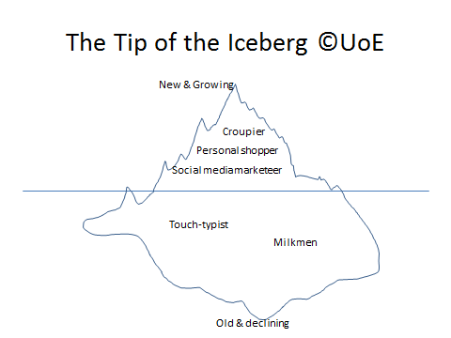
Student Exercise
Notes:
This is an example of a student exercise from ‘Exploring the world of work’ & how the labour mk is changing. Students work in small groups & are asked if the jobs in the picture are positioned in the right place if not why not? What 2 additional jobs – which have emerged in last 5 years - would they put in the new & growing section & what 2 additional jobs would they put in the old & declining – which have declined or disappeared in last 5 years & why. Then shown ‘you tube’ video – top 10 jobs didn’t exist 10 years ago.

Slide 36

5. Staff Career Management Guide

Slide 37
5. Staff Career Management Guide
Chapters:
Preparing the Course
Organising and Managing the Course
Delivering the Course
After the Course
Annexes:
Glossary of Terms
Framework of Student Career Management Competencies
Student Career Competencies Development Programme
4. Student Questionnaire before course
5. Student Questionnaire after course
Notes:
Explain that by far the biggest section is ‘Delivering the course’ – covers all topics in the student career management course & sections such as an outline lecture plan for each topic. Briefly describe chapters. Explain that ‘After the course’ covers evaluation & factors to take into account when adapting the course to the specific needs of your university

Slide 38
Session Plan
No. | Duration | Activities | Remarks
1 | 10 min. | Introduction | Broad introduction to the importance of understanding, researching and exploring career options and summary of topics to be covered: the graduate labour market occupational change career options with my degree the hidden job market and networking forms of employment
Notes:
This is a snap shot of a lesson plan on ‘Researching & exploring career options’ & is showing the topics that need to be covered. I was responsible for writing this & Martin covered self awareness & learning opportunities.

Slide 39
Session Plan
2 | 20 min. | The graduate labour market | Exercise, in the form of a quiz, highlighting sources of information on graduate labour market and testing student‘s perception of what this is. Students are given handout on How much do you know about the graduate labour market? Ask students to complete and then the tutor gives suggested answers to questions with explanation. There is an alternative quiz; `What are my options on leaving university?(which can be found in chapter 4 of the Student guide). Choose the one most appropriate to your group. Topic is concluded with a discussion involving the whole group on whether their perceptions have changed following exercise. See learning activities: exercise 2
Notes:
This is part of an explanation of how to deliver the session related to the graduate labour market

Slide 40

6. Guidelines for Career Education & Information Services
Purpose:
to describe strategic steps of implementation of career education & information services
this is an online resource accessed through the national Georgian careers website – see http://www.chemikariera.ge/en/
Notes:
If possible click on national careers website & show resource – not there at the moment but meant to be there under ‘resources’.

Slide 41
6. Guidelines for Career Education & Information Services
Structure:
Introduction
Career education & information services
Leadership & management
Planning of career education & information services
Implementation of career education & information services
Evaluation & quality improvement of career educational & information services
Notes:
A little bit like Matrix – if anyone is interested in what elements make up the different sections we can show you some more detail later or you can visit the national Georgian Careers website. For example leadership & management covers aspects such as how to write a mission statement & develop vision in the context of careers & is aimed at institutional leaders as well as those who will be running careers units. One of the successes of the project is the ‘buy in’ from government departments such as education – helped by the national TV media coverage at least 2 of the project meetings in Georgia. So hopefully these guidelines will be adopted across all Georgian HEI’s.

Slide 42
7. National career services website
Profiles of partner HE institutions
In Georgian & English
Target audience includes students, university staff, employers – see:
http://www.chemikariera.ge/en/
Notes:
Includes profiles of partner institutions & is open to all Georgian HEI’s who have some form of careers centre. An embryonic version of Graduate Prospects? Click on website & do a mini tour – choose a university eg University of Georgia & click on various options such as resources, events etc.

Slide 43
Project research data
Conducted by Georgian agency – ACT
Qualitative:
  Focus groups with students across HEIs (4 x 10)
  Focus groups (2) and interviews with HEI staff (2)
  In-depth interviews with employers (20 across sectors)
  In-depth interviews with staff from Georgian ministries (4)
Quantitative:
  Weighted sample of employer organisations across Georgia were surveyed face-to-face (300)

Slide 44
Barriers to employment entry:
Both groups identified common problems:
shortcomings in job applications (CVs, motivation letters)
low levels of foreign language competence
limited skills such as team working, analytical thinking, correctly spoken Georgian, and the ability to withstand stress
lack of motivation arising from poor career choice

Slide 45
Barriers to employment entry:
Students said employers:
Employers said students:
required work experience
preferred recruiting people they knew
lacked a clear career vision
showed inadequate ambition

Slide 46
In the workplace:
Both employers and graduates identified that:
graduates’ theoretical knowledge and practical skills, from their degree courses, were not always relevant to their jobs
graduates struggled to adapt to the work regime and routine
graduates had difficulty taking responsibility

Slide 47
In the workplace:
Graduates identified difficulties in:
Employers identified a lack of skills including:
establishing themselves in the workplace
dealing with the workload
team working
time management
working independently

Slide 48
What should be done?
Both groups considered HEIs to be the key environment for developing students’ attributes for successful integration into employment
Some overlap in what they felt HEIs ought to provide to help students overcome any barriers

Slide 49
What HEIs should be doing
Students
Employers
Teaching students about CVs/applications and interview performance
Organising teaching methods to develop presentation and team working skills
Facilitating internships and exchange programmes
Engaging employers more actively on campus
Helping students to develop their career vision
State encouragement of employer-based internships
Greater information exchange between employers and HEIs
More ‘open door days’ for students at large organisations

Slide 50
8. National Careers Partnership Initiative - purpose
Express shared understanding of importance of HE students’ career development
Agree priorities, objectives, approaches and co-operation to improve students’ employability through the development of the key skills and capabilities required by a global labour market
Creates the first common ground by which Georgian HEIs and other interested parties can:
share values, policies and expertise that will enhance students’ employability
develop future co-operation in this field
Notes:
An embryonic AGCAS? Georgian colleagues were taken to University College London for a visit & a member of the AGCAS Board explained how AGCAS works.

Slide 51
8. National Careers Partnership Initiative - priorities
Establishing and supporting the development of institutional careers units employing skilled professionals able to provide students with high quality career services
Supporting students in building their employability skills and competencies through education and training activities, and advisory consultations
Involving employers more directly in students’ career development activities
Facilitating links between students and employers to increase students’ understanding of, and exposure to, the world of work
Encouraging employers to share details of their current and/or future HR needs in order to ensure that students have access to up-to-date information

Slide 52
8. National Careers Partnership Initiative - Board
To provide strategic direction, establish working methods, facilitate communications, monitor activities, and establish dissemination methods
Members: partner HEIs plus employer representative organizations e.g. Chamber of Commerce, Georgian Business Association
Notes:
Inevitably there are some political tensions in setting this up – particularly as there is little previous history of HEI’s working together on such initiatives. The development of the national careers website could provide a focus for this partnership – particularly as this seems to have government backing.

Slide 53
Challenges
Language and culture
Different approaches to employability and career development learning
Different levels of awareness of above amongst Georgian partners
Georgian staff representation varied
Project communication challenges
Difficulties with editing of materials

Slide 54
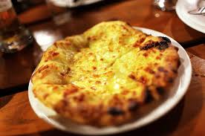



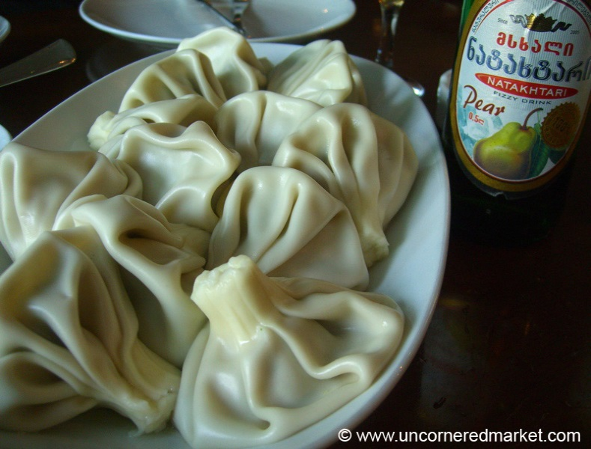
Georgian customs & culture
Notes:
Food is often served like a giant tapas with lots of different dishes to sample & then new dishes are brought to the table. Clean plates regularly replace the one you have just used to eat - Khachapuri – cheese filled bread, middle pot – Lobio - red bean soup, next bottom far left – Churchkhela – looks like a candle stick but is quite sweet. It is made by repeatedly dipping a long string of nuts into concentrated grapejuice. Walnuts are part of so many Georgian dishes – including Bazha – delicious thin walnut sauce, finally Khinkali – dumplings stuffed with juicy beef or pork or onions & spices or mushrooms – notice the bottle of pear water next to the Khinkali – flavoured water is now a major export for Georgia. But where is the milk? Posh Georgian restaurants are now becoming part of the London restaurant scene (eg trendy parts of Islington) often frequented by Russians.

Slide 55
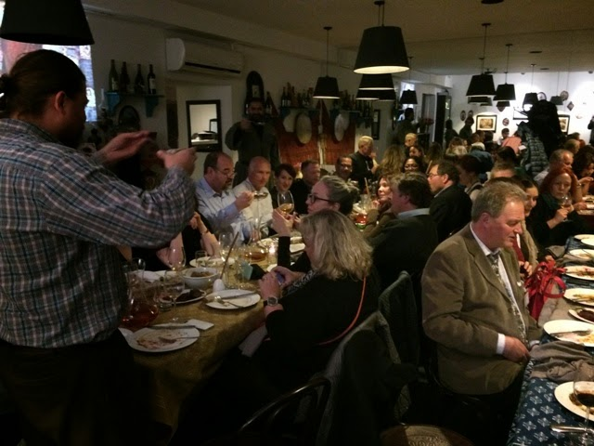
Toasting
Notes:
Georgia has quite a macho culture – it is not unusual to go to a local restaurant and find a group of men giving a series of toasts as part of the dinner party – this is known as a ‘Supra’. Often the man giving the toast stands on his chair. We however were working with Georgian female colleagues who were quite liberated & would each individually give a toast at the numerous dinners provided by our host university.

Slide 56

Georgian wines
Notes:
Georgian wines are becoming one of the main export industries. We often came home from a project meeting with a gift of Georgian wine from the host. Also in the country areas it is common for households to have there own mini grapevine & then make their own wine. This was very evident when we visited Telavi – which is north of Tbilisi at the foot of the Caucasus mountains.

Slide 57
დიდი მადლობა
(Thank you)
ნებისმიერი კითხვები?
(Any questions?)
Paul Hacking hackingpaul@googlemail.com
Martin Pennington martinpen@btinternet.com

